Slide 1
Introduction to Compartmental Models
Sophia Horigan
University of Chicago
Adapted from slides by:
Cara Brook, University of Chicago
Amy Wesolowski, Johns Hopkins University
Jessica Metcalf, Princeton University
Notes:
-salama daholo, Sophia no anarako
-I’m a phd student in cara’s lab at Uchicago, and I’m both a field and computational biologist interested in infectious diseases at the human wildlife interface
-very excited to be here today to talk about compartmental models
-this lecture will take us until lunch, then after lunch we’ll come back to do the R tutorial where we’ll get to apply some of the concepts we’ve learned today
-I’m going to do my best to speak slowly but I tend to talk fast when I get excited, so please don’t hesitate to raise your hands if you have any questions or want me to repeat anything
-I’ve built in a few check in points to help with this, but please interrupt me anytime
-we’ve included the French translation through many parts of this powerpoint, and Santino is standing by if anyone wants to discuss anything in Malagasy
-any questions? Alright let’s go!
-first off, how many of you have heard of compartmental modeling? Or used it in your research? (maybe ask what for)

Slide 2
Goals for this lecture
Understand the difference between statistical and mechanistic models Comprendre la différence entre les modèles statistiques et mécanistes.
Understand how to formalize and conceptualize compartmental models Comprendre comment on peut formuler et conceptualiser les modèles compartimentés
Example: population growth, predator prey, SIR models
Notes:
I’m going to start us off with some goals for the lecture, some key concepts that are the fundamental building blocks of compartmental modeling
If any of these words/concepts aren’t familiar to you, don’t worry, by the end of this time you’ll be very familiar!

Slide 3
Goals for this lecture
Understand the difference between statistical and mechanistic models Comprendre la différence entre les modèles statistiques et mécanistes.
Understand how to formalize and conceptualize compartmental models Comprendre comment on peut formuler et conceptualiser les modèles compartimentés
Example: population growth, predator prey, SIR models

Slide 4
Goals for this lecture
Understand the difference between statistical and mechanistic models Comprendre la différence entre les modèles statistiques et mécanistes.
Understand how to formalize and conceptualize compartmental models Comprendre comment on peut formuler et conceptualiser les modèles compartimentés
Example: population growth, predator prey, SIR models

Slide 5
Goals for this lecture
Understand the difference between statistical and mechanistic models Comprendre la différence entre les modèles statistiques et mécanistes.
Understand how to formalize and conceptualize compartmental models Comprendre comment on peut formuler et conceptualiser les modèles compartimentés
Example: population growth, predator prey, SIR models

Slide 6

?/?/? Models
Notes:
Going to start off with what a compartmental model is
There’s a lot of terminology in modeling, and so I want to point out that when we say compartmental model, we can also say mechanistic model, or mathematical model

Slide 7
Compartmental/Mechanistic/Mathematical/Dynamical Models
Notes:
Going to start off with what a compartmental model is
There’s a lot of terminology in modeling, and so I want to point out that when we say compartmental model, we can also say mechanistic model, or mathematical model

Slide 8
Compartmental/Mechanistic/Mathematical Models
Populations are divided into compartments Les populations sont subdivisées en compartiments
Individuals within a compartment are homogeneously mixed Les individus d'un compartiment sont mélangés de manière homogène
Compartments and transition rates are determined by biological systems Les compartiments et les taux de transition sont déterminés par les systèmes biologiques
Rates of transferring between compartments are expressed mathematically Taux de transition entre les compartiments sont exprimés mathématiquement

Slide 9
Compartmental/Mechanistic/Mathematical Models
Populations are divided into compartments Les populations sont subdivisées en compartiments
Individuals within a compartment are homogeneously mixed Les individus d'un compartiment sont mélangés de manière homogène
Compartments and transition rates are determined by biological systems Les compartiments et les taux de transition sont déterminés par les systèmes biologiques
Rates of transferring between compartments are expressed mathematically Taux de transition entre les compartiments sont exprimés mathématiquement

Slide 10
Compartmental/Mechanistic/Mathematical Models
Populations are divided into compartments Les populations sont subdivisées en compartiments
Individuals within a compartment are homogeneously mixed Les individus d'un compartiment sont mélangés de manière homogène
Compartments and transition rates are determined by biological systems Les compartiments et les taux de transition sont déterminés par les systèmes biologiques
Rates of transferring between compartments are expressed mathematically Taux de transition entre les compartiments sont exprimés mathématiquement

Slide 11
Compartmental/Mechanistic/Mathematical Models
Populations are divided into compartments Les populations sont subdivisées en compartiments
Individuals within a compartment are homogeneously mixed Les individus d'un compartiment sont mélangés de manière homogène
Compartments and transition rates are determined by biological systems Les compartiments et les taux de transition sont déterminés par les systèmes biologiques
Rates of transferring between compartments are expressed mathematically Taux de transition entre les compartiments sont exprimés mathématiquement
Notes:
These are the FOUR GOLDEN RULES, and for the rest of the lecture, we’re going to see how we can apply these four golden rules to different questions to build models

Slide 12
How are these different from statistical models? En quoi sont-ils différents des modèles statistiques?
Make explicit hypotheses about biological mechanisms that drive infection dynamics (may not be realistic, but still explicit)
Faire des hypothèses explicites sur les mécanismes biologiques qui régissent la dynamique de l'infection (peut ne pas être réaliste, mais toujours explicite)

Slide 13
How are these different from statistical models? En quoi sont-ils différents des modèles statistiques?
Make explicit hypotheses about biological mechanisms that drive dynamics (may not be realistic, but still explicit)
Faire des hypothèses explicites sur les mécanismes biologiques qui régissent la dynamique de l'infection (peut ne pas être réaliste, mais toujours explicite)

Slide 14
1. Simple Population Models 1. Modèles simples de population

Slide 15
Madagascar
What can we say about the population of Madagascar?
How would a model help us? What kind of model should we use?
http://databank.worldbank.org
Notes:
This plot shows the population of Madagascar over time, from 1960 to 2010.
Just by looking at it we can learn a few things:
it’s increasing
It looks like its increasing more and more quickly over time
Just looking at it is helpful, but if we want to A) understand exactly how it’s changing over time, and B) be able to predict future change, we can create a compartmental model that captures these dynamics
And this type of model is of course, a basic population model

Slide 16
The basic
population model
Compartmental models (Mechanistic Models)
Populations are divided into compartments
Individuals within a compartment are homogenously mixed
3. Compartments and transition rates are
determined by biological systems
4. Rates of transferring between compartments
are expressed mathematically
Compartmental models (Mechanistic Models)
1. Les populations sont subdivisées en compartiments
2. Les individus d'un compartiment sont mélangés de manière homogène
3. Les compartiments et les taux de transition sont déterminés par les systèmes biologiques
4. Taux de transition entre les compartiments sont exprimés mathématiquement
Notes:
So the basic population model has to follow the same rules of all compartmental models that we talked about a few minutes ago
First,

Slide 17
The basic
population model
Compartmental models (Mechanistic Models)
Populations are divided into compartments
Individuals within a compartment are homogenously mixed
3. Compartments and transition rates are
determined by biological systems
4. Rates of transferring between compartments
are expressed mathematically
Compartmental models (Mechanistic Models)
1. Les populations sont subdivisées en compartiments
2. Les individus d'un compartiment sont mélangés de manière homogène
3. Les compartiments et les taux de transition sont déterminés par les systèmes biologiques
4. Taux de transition entre les compartiments sont exprimés mathématiquement

Slide 18
The basic
population model
Compartmental models (Mechanistic Models)
Populations are divided into compartments
Individuals within a compartment are homogenously mixed
3. Compartments and transition rates are
determined by biological systems
4. Rates of transferring between compartments
are expressed mathematically
Compartmental models (Mechanistic Models)
1. Les populations sont subdivisées en compartiments
2. Les individus d'un compartiment sont mélangés de manière homogène
3. Les compartiments et les taux de transition sont déterminés par les systèmes biologiques
4. Taux de transition entre les compartiments sont exprimés mathématiquement

Slide 19
The basic
population model
Compartmental models (Mechanistic Models)
Populations are divided into compartments
Individuals within a compartment are homogenously mixed
3. Compartments and transition rates are
determined by biological systems
4. Rates of transferring between compartments
are expressed mathematically
Compartmental models (Mechanistic Models)
1. Les populations sont subdivisées en compartiments
2. Les individus d'un compartiment sont mélangés de manière homogène
3. Les compartiments et les taux de transition sont déterminés par les systèmes biologiques
4. Taux de transition entre les compartiments sont exprimés mathématiquement

Slide 20
The basic
population model
Compartmental models (Mechanistic Models)
1. Populations are divided into compartments
2. Compartments and transition rates are
determined by biological systems
3. Rates of transferring between compartments
are expressed mathematically
4. Individuals within a compartment are homogenously mix
How does the population of Madagascar grow over time?
Comment est-ce que la population de Madagascar s’augmente avec le passage du temps?
Notes:
If we are able to make a model that follows all of those rules, we’ll be able to answer our core question: how does the population mof Madagascar grow over time?
So let’s walk through how we can implement each of these rules

Slide 21
The basic
population model
Compartmental models (Mechanistic Models)
1. Populations are divided into compartments
2. Individuals within a compartment are homogenously mixed
3. Compartments and transition rates are
determined by biological systems
4. Rates of transferring between compartments
are expressed mathematically
Madagascar
(N)
Square = compartment
N = state variable = the data we want to explain
What is the precise definition of N?
Notes:
Compartment is a state that our variable of interest is in, which is typically represented by a square like this.
So in this case, the variable we want to model is population size, or ‘the number of people that are alive at any given time in Madagascar’, represented here by N
Because this is our variable of interest that we capture in one of these compartments, we call it a ‘state variable’
In this model, there’s only one state variable, only one compartment.
So check on number 1, we’ve identified our compartment

Slide 22
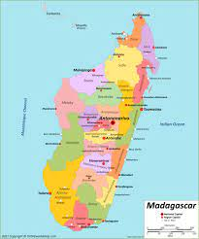
The basic
population model
Compartmental models (Mechanistic Models)
1. Populations are divided into compartments
2. Individuals within a compartment are homogenously mixed
3. Compartments and transition rates are
determined by biological systems
4. Rates of transferring between compartments
are expressed mathematically
Madagascar
(N)
Notes:
On to number two, …
Very realistically, if we think about people living in Madagascar at any given time, there’s spatial segregation. People tend to mix within their own community or city much more than they mix with people from a different community or city, particularly one that’s very far away.
I’ve represented that by this variation in color here, in reality, green mixes more with green, brown more with brown, etc.
But in order to simplify reality and abide by the four golden rules, we instead assume that everyone across all of Madagascar all mixes the same

Slide 23
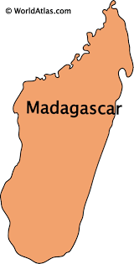
The basic
population model
Compartmental models (Mechanistic Models)
1. Populations are divided into compartments
2. Individuals within a compartment are homogenously mixed
3. Compartments and transition rates are
determined by biological systems
4. Rates of transferring between compartments
are expressed mathematically
Madagascar
(N)
Notes:
So here we go, now instead of the variation in color we’re going to just make it one solid green to represent everyone mixing around together.

Slide 24
The basic
population model
Compartmental models (Mechanistic Models)
1. Populations are divided into compartments
2. Compartments and transition rates are
determined by biological systems
3. Rates of transferring between compartments
are expressed mathematically
4. Individuals within a compartment are homogenously mix
Madagascar
(N)
How does the population grow?
Notes:
Great! So we’ve checked off numbers 1 and 2, we have our compartment of population mixing together.
The next thing we want to capture is how our state variable, N, is going to be changing over time. What biological mechanisms are happening to N that would impact its dynamics.
In other words, how does the population grow?
So here’s another question for you: what processes or mechanisms impact the size of N?
(I’m looking for two main things)

Slide 25
The basic
population model
Compartmental models (Mechanistic Models)
1. Populations are divided into compartments
2. Individuals within a compartment are homogenously mixed
3. Compartments and transition rates are
determined by biological systems
4. Rates of transferring between compartments
are expressed mathematically
births
Madagascar
(N)
How does the population decrease?
Notes:
two things can happen - birth or death (ignoring migration)
rate = r (= speed per unit time)
flow = rate * pop

Slide 26
The basic
population model
Compartmental models (Mechanistic Models)
1. Populations are divided into compartments
2. Individuals within a compartment are homogenously mixed
3. Compartments and transition rates are
determined by biological systems
4. Rates of transferring between compartments
are expressed mathematically
births
Madagascar
(N)
deaths
What is a big assumption we are making here?
Notes:
Rate
Assume every individual has the same birth and death rate

Slide 27
The basic
population model
Compartmental models (Mechanistic Models)
1. Populations are divided into compartments
2. Individuals within a compartment are homogenously mixed
3. Compartments and transition rates are
determined by biological systems
4. Rates of transferring between compartments
are expressed mathematically
births
Madagascar
(N)
deaths
N_{t+1}=births*N_{t}-deaths*N_{t}
Notes:
Alright, onto the final golden rule, number four…..
Aka: let’s write our model as an equation
Again, we want to understand how our state variable, N, changes over time. In other words, what is the value of N at the next time point? (Nt+1)

Slide 28
The basic
population model
Compartmental models (Mechanistic Models)
1. Populations are divided into compartments
2. Individuals within a compartment are homogenously mixed
3. Compartments and transition rates are
determined by biological systems
4. Rates of transferring between compartments
are expressed mathematically
births
Madagascar
(N)
deaths
N_{t+1}=births*N_{t}-deaths*N_{t}
Notes:
We’ve already identified our mechanisms of change, our rates, so let’s include them here
Nt+1 is increased by births (birth rate times Nt)

Slide 29
The basic
population model
Compartmental models (Mechanistic Models)
1. Populations are divided into compartments
2. Individuals within a compartment are homogenously mixed
3. Compartments and transition rates are
determined by biological systems
4. Rates of transferring between compartments
are expressed mathematically
births
Madagascar
(N)
deaths
N_{t+1}=births*N_{t}-deaths*N_{t}
Notes:
And decreased by deaths (death rate * Nt)

Slide 30
The basic
population model
Compartmental models (Mechanistic Models)
1. Populations are divided into compartments
2. Individuals within a compartment are homogenously mixed
3. Compartments and transition rates are
determined by biological systems
4. Rates of transferring between compartments
are expressed mathematically
births
Madagascar
(N)
deaths
N_{t+1}=births*N_{t}-deaths*N_{t}
N_{t+1}=(births-deaths)*N_{t}
N_{t+1}=λ*N_{t}
λ=pop intrinsic growth rate
Notes:
If we do some shuffling around and factor the Nt out of both terms, we are able to isolate the births-deaths, which is what we classically represent as lamba, or the population’s intrinsic growth rate
Now we are able to calculate the value of Nt+1, if we know the value of lambda and Nt

Slide 31

What are the main assumptions of a simple population model?
Closed population
Homogenous mixing
Same birth and death rate for each person
What is lambda?
Population intrinsic growth rate

Slide 32
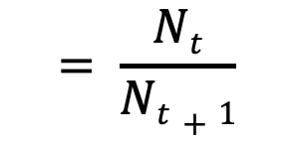

The basic
population model
births
Madagascar
(N)
deaths
Population rate of increase
Taux d'accroissement de la population
$$λ$$
$$= \frac{Nt}{Nt+1}$$
pop size at t
pop size at t+1
This is for one time step, how do we generalize this equation to work for all time steps?
Notes:
So let’s look at how we can use this lambda value to plot populations over time
If we solve for lambda, we see that it equals ===
t+1 here could mean 1 year in the future, often done for human populations.
what happens if you start at N[0] ? [make them walk through it! make them identify that we are assuming that population growth stays the SAME]

Slide 33
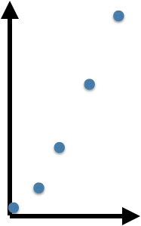


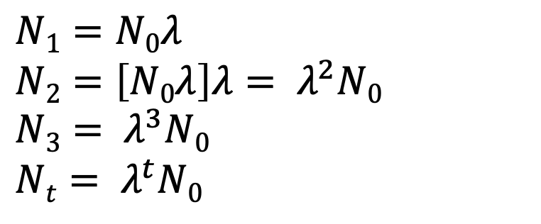
The basic
population model
births
Madagascar
(N)
deaths
Discrete time
$$λ$$
$$= \frac{Nt}{Nt+1}$$
$$N1=N0λ$$
$N2=\left[N0λ\right]λ= λ^{2}N0$
$N3= λ^{3}N0$
$Nt= λ^{t}N0$
Notes:
Now let’s build this into our general population model equation.
To do that, let’s start at N0, assuming there’s just a few individuals. What does N1 =?
What about N2?
N3?
Can anyone generalize the pattern?
Allows us to estimate the population at any time point t if we know the intrinsic growth rate and the starting population
What is a key assumption about lambda here?
What about the key values of lambda? [1 = equilibrium; <1 = shrink; >1 grow]
So far, we’ve been dealing in discrete time. T = 1 year, individual points.
But what if we want a continuous time equation? Instead of individual points at year intervals, we want to know the value of N at every single possible point

Slide 34
The basic
population model
births
Madagascar
(N)
deaths
Discrete time
$$λ$$
$$= \frac{Nt}{Nt+1}$$
$$N1=N0λ$$
$N2=\left[N0λ\right]λ= λ^{2}N0$
$N3= λ^{3}N0$
$Nt= λ^{t}N0$
Notes:
Now let’s build this into our general population model equation.
To do that, let’s start at N0, assuming there’s just a few individuals. What does N1 =?
What about N2?
N3?
Can anyone generalize the pattern?
Allows us to estimate the population at any time point t if we know the intrinsic growth rate and the starting population
What is a key assumption about lambda here?
What about the key values of lambda? [1 = equilibrium; <1 = shrink; >1 grow]
So far, we’ve been dealing in discrete time. T = 1 year, individual points.
But what if we want a continuous time equation? Instead of individual points at year intervals, we want to know the value of N at every single possible point

Slide 35
The basic
population model
births
Madagascar
(N)
deaths
Discrete time
$$λ$$
$$= \frac{Nt}{Nt+1}$$
$$N1=N0λ$$
$N2=\left[N0λ\right]λ= λ^{2}N0$
$N3= λ^{3}N0$
$Nt= λ^{t}N0$
Notes:
Now let’s build this into our general population model equation.
To do that, let’s start at N0, assuming there’s just a few individuals. What does N1 =?
What about N2?
N3?
Can anyone generalize the pattern?
Allows us to estimate the population at any time point t if we know the intrinsic growth rate and the starting population
What is a key assumption about lambda here?
What about the key values of lambda? [1 = equilibrium; <1 = shrink; >1 grow]
So far, we’ve been dealing in discrete time. T = 1 year, individual points.
But what if we want a continuous time equation? Instead of individual points at year intervals, we want to know the value of N at every single possible point

Slide 36
The basic
population model
births
Madagascar
(N)
deaths
Discrete time
$$λ$$
$$= \frac{Nt}{Nt+1}$$
$$N1=N0λ$$
$N2=\left[N0λ\right]λ= λ^{2}N0$
$N3= λ^{3}N0$
$Nt= λ^{t}N0$
Notes:
Now let’s build this into our general population model equation.
To do that, let’s start at N0, assuming there’s just a few individuals. What does N1 =?
What about N2?
N3?
Can anyone generalize the pattern?
Allows us to estimate the population at any time point t if we know the intrinsic growth rate and the starting population
What is a key assumption about lambda here?
What about the key values of lambda? [1 = equilibrium; <1 = shrink; >1 grow]
So far, we’ve been dealing in discrete time. T = 1 year, individual points.
But what if we want a continuous time equation? Instead of individual points at year intervals, we want to know the value of N at every single possible point

Slide 37
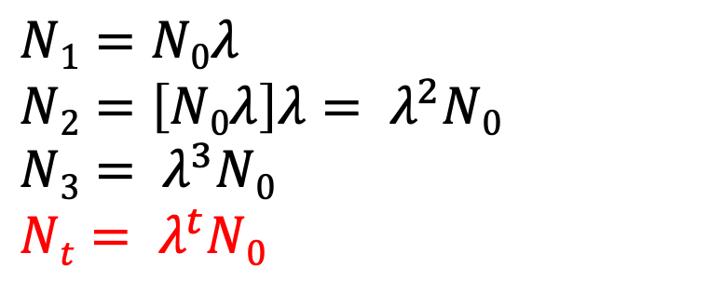
The basic
population model
births
Madagascar
(N)
deaths
Discrete time
$$λ$$
$$= \frac{Nt}{Nt+1}$$
$$N1=N0λ$$
$N2=\left[N0λ\right]λ= λ^{2}N0$
$N3= λ^{3}N0$
$Nt= λ^{t}N0$
Notes:
Now let’s build this into our general population model equation.
To do that, let’s start at N0, assuming there’s just a few individuals. What does N1 =?
What about N2?
N3?
Can anyone generalize the pattern?
Allows us to estimate the population at any time point t if we know the intrinsic growth rate and the starting population
What is a key assumption about lambda here?
What about the key values of lambda? [1 = equilibrium; <1 = shrink; >1 grow]
So far, we’ve been dealing in discrete time. T = 1 year, individual points.
But what if we want a continuous time equation? Instead of individual points at year intervals, we want to know the value of N at every single possible point

Slide 38
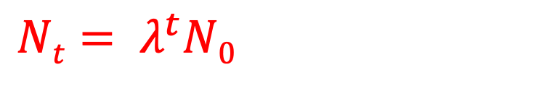
The basic
population model
births
Madagascar
(N)
deaths
Discrete time
What if we want to know the population size for any time t? Not just where we have data?
$$λ$$
$$= \frac{Nt}{Nt+1}$$
$Nt= λ^{t}N0$
Notes:
Now let’s build this into our general population model equation.
To do that, let’s start at N0, assuming there’s just a few individuals. What does N1 =?
What about N2?
N3?
Can anyone generalize the pattern?
Allows us to estimate the population at any time point t if we know the intrinsic growth rate and the starting population
What is a key assumption about lambda here?
What about the key values of lambda? [1 = equilibrium; <1 = shrink; >1 grow]
So far, we’ve been dealing in discrete time. T = 1 year, individual points.
But what if we want a continuous time equation? Instead of individual points at year intervals, we want to know the value of N at every single possible point

Slide 39
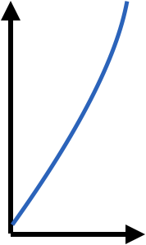
The basic
population model
births
Madagascar
(N)
deaths
Discrete time
Continuous time
population size, N_{t}
$$λ$$
$$= \frac{Nt}{Nt+1}$$
population size, N_{t}
!as t→0
time
time
How do we get the same type of equation but for continuous time?
$Nt= λ^{t}N0$
Notes:
We can convert this equation to a differential equation
To start, we need to figure out the intrinsic growth rate. In continuous time, we often represent the intrinsic growth rate as r instead of lambda. EQUATION.
For continuous time, we want to know the change in N over the change in time for every time time point.

Slide 40
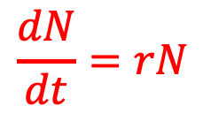

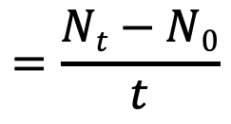
The basic
population model
births
Madagascar
(N)
deaths
Discrete time
Continuous time
population size, N_{t}
$$λ$$
$$= \frac{Nt}{Nt+1}$$
population size, N_{t}
$$r$$
$$=\frac{Nt−N0}{t}$$
!as t→0
time
time
$Nt= λ^{t}N0$
$$\frac{dN}{dt}=rN$$
Notes:
We can convert this equation to a differential equation
To start, we need to figure out the intrinsic growth rate. In continuous time, we often represent the intrinsic growth rate as r instead of lambda. EQUATION.
For continuous time, we want to know the change in N over the change in time for every time time point.

Slide 41
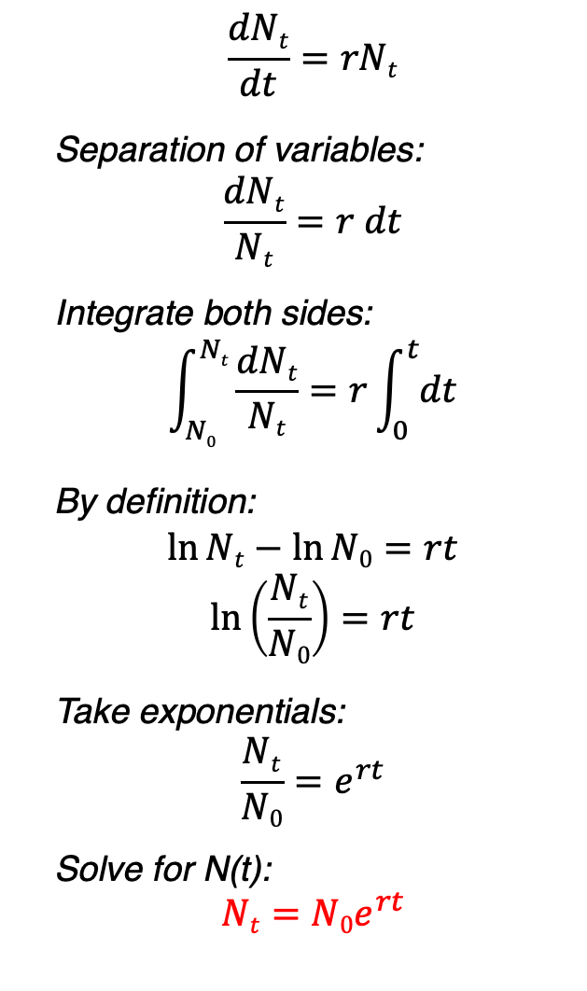
The basic
population model
Continuous time
$$\frac{dNt}{dt}=rNt$$
Separation of variables:
$$\frac{dNt}{Nt}=r dt$$
Integrate both sides:
$$\int_{N0}^{Nt}{\frac{dNt}{Nt}}=r\int_{0}^{t}{dt}$$
By definition:
$$\ln{Nt}−\ln{N0}=rt$$
$$\ln\left(\frac{Nt}{N0}\right)=rt$$
Take exponentials:
$$\frac{Nt}{N0}=e^{rt}$$
Solve for N(t):
$$Nt=N0e^{rt}$$
Discrete time
population size, N_{t}
time
$Nt= λ^{t}N0$
Notes:
integral of dx/x is log(x);
integral of a constant is the constant *x + c
log(P(t)) = rt+c just by rules of derivative
C is N(0)?

Slide 42
The basic
population model
Continuous time
$$\frac{dNt}{dt}=rNt$$
Separation of variables:
$$\frac{dNt}{Nt}=r dt$$
Integrate both sides:
$$\int_{N0}^{Nt}{\frac{dNt}{Nt}}=r\int_{0}^{t}{dt}$$
By definition:
$$\ln{Nt}−\ln{N0}=rt$$
$$\ln\left(\frac{Nt}{N0}\right)=rt$$
Take exponentials:
$$\frac{Nt}{N0}=e^{rt}$$
Solve for N(t):
$$Nt=N0e^{rt}$$
Discrete time
population size, N_{t}
time
$Nt= λ^{t}N0$
Notes:
integral of dx/x is log(x);
integral of a constant is the constant *x + c
log(P(t)) = rt+c just by rules of derivative
C is N(0)?

Slide 43
The basic
population model
Continuous time
$$\frac{dNt}{dt}=rNt$$
Separation of variables:
$$\frac{dNt}{Nt}=r dt$$
Integrate both sides:
$$\int_{N0}^{Nt}{\frac{dNt}{Nt}}=r\int_{0}^{t}{dt}$$
By definition:
$$\ln{Nt}−\ln{N0}=rt$$
$$\ln\left(\frac{Nt}{N0}\right)=rt$$
Take exponentials:
$$\frac{Nt}{N0}=e^{rt}$$
Solve for N(t):
$$Nt=N0e^{rt}$$
Discrete time
population size, N_{t}
time
$Nt= λ^{t}N0$
Notes:
integral of dx/x is log(x);
integral of a constant is the constant *x + c
log(P(t)) = rt+c just by rules of derivative
C is N(0)?

Slide 44
The basic
population model
Continuous time
$$\frac{dNt}{dt}=rNt$$
Separation of variables:
$$\frac{dNt}{Nt}=r dt$$
Integrate both sides:
$$\int_{N0}^{Nt}{\frac{dNt}{Nt}}=r\int_{0}^{t}{dt}$$
By definition:
$$\ln{Nt}−\ln{N0}=rt$$
$$\ln\left(\frac{Nt}{N0}\right)=rt$$
Take exponentials:
$$\frac{Nt}{N0}=e^{rt}$$
Solve for N(t):
$$Nt=N0e^{rt}$$
Discrete time
population size, N_{t}
time
$Nt= λ^{t}N0$
Notes:
integral of dx/x is log(x);
integral of a constant is the constant *x + c
log(P(t)) = rt+c just by rules of derivative
C is N(0)?

Slide 45
The basic
population model
Continuous time
$$\frac{dNt}{dt}=rNt$$
Separation of variables:
$$\frac{dNt}{Nt}=r dt$$
Integrate both sides:
$$\int_{N0}^{Nt}{\frac{dNt}{Nt}}=r\int_{0}^{t}{dt}$$
By definition:
$$\ln{Nt}−\ln{N0}=rt$$
$$\ln\left(\frac{Nt}{N0}\right)=rt$$
Take exponentials:
$$\frac{Nt}{N0}=e^{rt}$$
Solve for N(t):
$$Nt=N0e^{rt}$$
Discrete time
population size, N_{t}
time
$Nt= λ^{t}N0$
Notes:
integral of dx/x is log(x);
integral of a constant is the constant *x + c
log(P(t)) = rt+c just by rules of derivative
C is N(0)?

Slide 46
The basic
population model
Continuous time
$$\frac{dNt}{dt}=rNt$$
Separation of variables:
$$\frac{dNt}{Nt}=r dt$$
Integrate both sides:
$$\int_{N0}^{Nt}{\frac{dNt}{Nt}}=r\int_{0}^{t}{dt}$$
By definition:
$$\ln{Nt}−\ln{N0}=rt$$
$$\ln\left(\frac{Nt}{N0}\right)=rt$$
Take exponentials:
$$\frac{Nt}{N0}=e^{rt}$$
Solve for N(t):
$$Nt=N0e^{rt}$$
Discrete time
population size, N_{t}
time
$Nt= λ^{t}N0$
Notes:
integral of dx/x is log(x);
integral of a constant is the constant *x + c
log(P(t)) = rt+c just by rules of derivative
C is N(0)?

Slide 47


The basic
population model
births
Madagascar
(N)
deaths
Discrete time
Continuous time
population size, N_{t}
$$λ$$
$$= \frac{Nt}{Nt+1}$$
population size, N_{t}
$$r$$
$$=\frac{Nt−N0}{t}$$
!as t→0
time
time
$Nt= λ^{t}N0$
$$Nt=N0e^{rt}$$
Notes:
We have derived our two closed form equations for basic population growth: discrete time and continuous time
continuous need calculus; discrete usually only algebra…

Slide 48
The basic
population model
births
Madagascar
(N)
deaths
Discrete
Continuous
Continuous models can be discretized; discrete models can be approximated by continuous ones. The appropriate framing may depend on the data / question.
Notes:
you can often convert between the two, etc
but lets go back to discrete time for a second.

Slide 49

What is the difference between discrete and continuous models?
Discrete: state variable only changes at distinct time steps
Continuous: state variables change continuously (tiny tiny time steps)
What math is used in discrete pop models? Continuous pop models?
Algebra, calculus

Slide 50
The basic
population model
births
Madagascar
(N)
deaths
What about those rates?
Are they the same every year?
And in every person? Why might they be different?
Reproductive age
Death rate increasing with age
Diseases/other health factors
How do we incorporate this ‘randomness’?
Notes:
We identified earlier that one of the key assumptions of this basic model so far is that the birth and death rates are constant. But is that the case in reality? What are some reasons that they might be different?
(reproductive age, death rate increases with age, health factors)
That question brings us to another key idea in compartmental modeling, deterministic vs stochastic models

Slide 51

The basic
population model
births
Madagascar
(N)
deaths
if deterministic
“always the same”
probability of death = 0.5
Notes:
Let’s use ducks as an example. Suppose we are looking at how the population of ducks changes over time, let’s say in discrete time of one year.
If we assume that the probability of death (i.e. the death rate) is constant, that means that we are absolutely sure that half of these ducks will die before the next year.

Slide 52

The basic
population model
births
Madagascar
(N)
deaths
if deterministic
“always the same”
probability of death = 0.5
Notes:
Leaving us with 5 ducks from our starting population of 10. this is an example of a deterministic model– our rates are fixed, constant, always the same, and we know exactly how the population changes year to year, every year.

Slide 53
The basic
population model
births
Madagascar
(N)
deaths
if deterministic
“always the same”
probability of death = 0.5
if stochastic?
“up to chance”
probability of death = 0.5
Notes:
But if we want our model to factor in some variation in the death rate (for the reasons we stated above) from year to year to try and be more realistic, we can use what’s called a stochastic model. Stochastic means ’up to chance’.
So let’s say in our stochastic model we start with the same 10 ducks, and the same probability of death

Slide 54

The basic
population model
births
Madagascar
(N)
deaths
if deterministic
“always the same”
probability of death = 0.5
if stochastic?
“up to chance”
probability of death = 0.5
Notes:
What we’ll see with a stochastic model is that some years, we get more death than the expected 0.5, and some years we get less. So in this case, we had a higher death rate (0.8), leaving us with only 2 surviving ducks.

Slide 55
The basic
population model
births
Madagascar
(N)
deaths
if deterministic
“always the same”
probability of death = 0.5
if stochastic?
“up to chance”
probability of death = 0.5
Notes:
What we’ll see with a stochastic model is that some years, we get more death than the expected 0.5, and some years we get less. So in this case, we had a higher death rate (0.8), leaving us with only 2 surviving ducks.

Slide 56
The basic
population model
births
Madagascar
(N)
deaths
if deterministic
“always the same”
probability of death = 0.5
rbinom(200,10,0.5)
if stochastic?
probability of death = 0.5
Notes:
Now the way that we do that is instead of having a fixed value of death rate (rate = 0.5 every year), we instead draw a value of the death rate from a distribution.
So each time point, we select some random value from this distribution that we use as our number of surviving ducks. Sometimes it is 5, sometimes it is more or less.

Slide 57
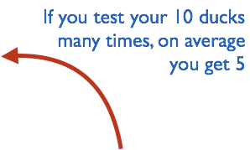
The basic
population model
births
Madagascar
(N)
deaths
if deterministic
“always the same”
probability of death = 0.5
rbinom(200,10,0.5)
if stochastic?
probability of death = 0.5
Notes:
Crucially though, on average, we get 5 surviving ducks, and that’s represented by the shape of this distribution. We are most likely to get 5 surviving ducks.

Slide 58
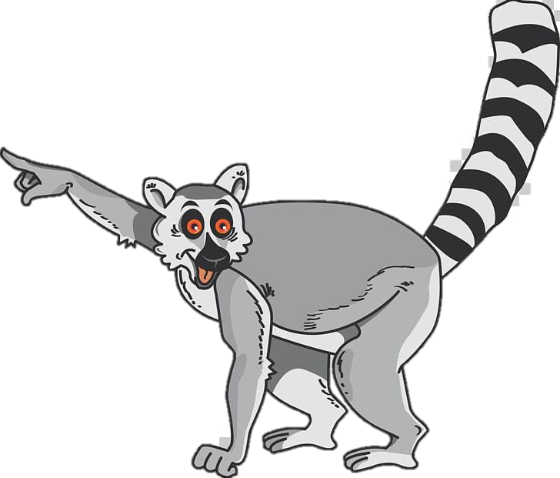
What is the difference between deterministic and stochastic?
Deterministic = always the same
Stochastic = up to chance
Notes:
Now we’re going to apply these concepts to more complex models, starting with structured population models.

Slide 59
Key concepts
Compartmental/mechanistic/mathematical models
Modèles en compartiments
Continuous vs. discrete models
Modèles en temps continue vs. modèles en temps discrète
Deterministic vs. stochastic models
Modèles détérministique vs. stochastique

Slide 60
2. Structured Population Models 2. Modèles de la population structurée

Slide 61
The structured
population model
births
Ranomafana
(N)
deaths
data
Why does the model perform poorly?
model
population size, N_{t}
time
Notes:
Let’s go back to discrete time, and think about developing a model that describes the population of Ranomafana.
In this example, our data of real life counts of the population size are represented by red dots, and our estimate of the population size based on our simple discrete population model is represented by the blue line.
And we can see that the model doesn’t fit the data very well, i.e. the line doesn’t match up with the red dots.
we’ve touched on a few of these already, but what are some of the key assumptions of the simple population model that might make this projection so far off?
1) Time varying lambda 2) reproductive age.

Slide 62
The basic
population model
Why does the model perform poorly?
births
Ranomafana
(N)
deaths
data
We need population structure!
That means distinguishing babies from adults.
model
population size, N_{t}
time
Notes:
In other words, we need population structure! In other words, we need a way to distinguish babies from adults, so that we can account for the fact that babies aren’t reproducing.

Slide 63
The structured
population model
Compartmental models (Mechanistic Models)
1. Populations are divided into compartments
2. Individuals within a compartment are homogenously mixed
3. Compartments and transition rates are
determined by biological systems
4. Rates of transferring between compartments
are expressed mathematically
How does the population of Ranomafana grow over time?
Comment est-ce que la population de Ranomafana s’augmente avec le passage du temps?
Notes:
So let’s go back to our four golden rules, and our main question, and build a structured population model.

Slide 64
The structured
population model
Compartmental models (Mechanistic Models)
1. Populations are divided into compartments
2. Individuals within a compartment are homogenously mixed
3. Compartments and transition rates are
determined by biological systems
4. Rates of transferring between compartments
are expressed mathematically
Babies
Adults
Notes:
Two compartments, babies and adults

Slide 65
The structured
population model
Compartmental models (Mechanistic Models)
1. Populations are divided into compartments
2. Individuals within a compartment are homogenously mixed
3. Compartments and transition rates are
determined by biological systems
4. Rates of transferring between compartments
are expressed mathematically
Babies
Adults
Notes:
Flat colors = homogenously mixed

Slide 66
The structured
population model
Compartmental models (Mechanistic Models)
1. Populations are divided into compartments
2. Individuals within a compartment are homogenously mixed
3. Compartments and transition rates are
determined by biological systems
4. Rates of transferring between compartments
are expressed mathematically
births
Babies
aging
Adults
deaths
deaths
Notes:
what are the arrows?

Slide 67
The structured
population model
Compartmental models (Mechanistic Models)
1. Populations are divided into compartments
2. Individuals within a compartment are homogenously mixed
3. Compartments and transition rates are
determined by biological systems
4. Rates of transferring between compartments
are expressed mathematically
births (B)
Babies
aging
(a)
Adults
deaths
deaths
N_{t+1}=λ*N_{t}
vector of
population sizes
matrix of rates
pop size at t
pop size at t + 1
Population rate of increase
*Discrete time
Taux d'accroissement de la population
Notes:
So this was our equation for the basic population model
Our equation for a structured population model has the same format, nt+1 = growth * nt
But in this case, because we have multiple states, lambda is replaced by A, a matrix of population growth rates
And nt is a vector of population sizes instead of a single number

Slide 68
The structured
population model
Compartmental models (Mechanistic Models)
1. Populations are divided into compartments
2. Individuals within a compartment are homogenously mixed
3. Compartments and transition rates are
determined by biological systems
4. Rates of transferring between compartments
are expressed mathematically
births (B)
Babies
aging
(a)
Adults
deaths
deaths
A
n_{t}
n_{t+1}
s_{b}(1-a)
B
n_{b}
s_{b}(1-a) n_{b} + bn_{a}
x
=
s_{b}a
s_{a}
n_{a}
s_{b} a n_{b} + s_{a}n_{a}
Notes:
So let’s expand that out to understand it more deeply.
A is a matrix that includes all
N has pop size of b and a
Do some matrix math, get nt+1

Slide 69
The structured
population model
Compartmental models (Mechanistic Models)
1. Populations are divided into compartments
2. Individuals within a compartment are homogenously mixed
3. Compartments and transition rates are
determined by biological systems
4. Rates of transferring between compartments
are expressed mathematically
births (B)
Babies
aging
(a)
Adults
deaths
deaths
A
n_{t}
n_{t+1}
s_{b}(1-a)
B
n_{b}
s_{b}(1-a) n_{b} + bn_{a}
x
=
s_{b}a
s_{a}
n_{a}
s_{b} a n_{b} + s_{a}n_{a}
Population growth will depend on population structure!
Notes:
The key takeaway from this is that population growth will depend on population structure

Slide 70
Key concepts
Compartmental/mechanistic/mathematical models
Modèles en compartiments
Continuous vs. discrete models
Modèles en temps continue vs. modèles en temps discrète
Deterministic vs. stochastic models
Modèles détérministique vs. stochastique
Structured models
Modèles structurés.

Slide 71

How do we modify a basic population model to make it structured?
Two compartments (adults and babies)
Vector/matrix of values

Slide 72
3. Two-population model 3. modèles de deux populations
Notes:
Model in which two populations interact.
Predator prey

Slide 73
The predator-prey model
Compartmental models (Mechanistic Models)
1. Populations are divided into compartments
2. Individuals within a compartment are homogenously mixed
3. Compartments and transition rates are
determined by biological systems
4. Rates of transferring between compartments
are expressed mathematically
How does the population of fossa regulate the population of lemurs in Ranomafana?
Comment la population de “fossa” régule la population de lemuriens à Ranomafana?
Notes:
Back to our rules and question

Slide 74
The predator-prey model
Compartmental models (Mechanistic Models)
1. Populations are divided into compartments
2. Individuals within a compartment are homogenously mixed
3. Compartments and transition rates are
determined by biological systems
4. Rates of transferring between compartments
are expressed mathematically
lemur
(x)
fossa
(y)

Slide 75
The predator-prey model
Compartmental models (Mechanistic Models)
1. Populations are divided into compartments
2. Individuals within a compartment are homogenously mixed
3. Compartments and transition rates are
determined by biological systems
4. Rates of transferring between compartments
are expressed mathematically
lemur
(x)
fossa
(y)

Slide 76
The predator-prey model
Compartmental models (Mechanistic Models)
1. Populations are divided into compartments
2. Individuals within a compartment are homogenously mixed
3. Compartments and transition rates are
determined by biological systems
4. Rates of transferring between compartments
are expressed mathematically
lemur reproduction
lemur
(x)
lemur death
fossa reproduction
fossa
(y)
fossa death
Notes:
currently we just have two separate basic population models, but the key concept here is that these populations interact.
Can anyone think of a way in which any of these mechanisms could be influenced by the other species?
Fossa reproduction depends on lemur population (food converted to energy)
Lemur death depends on fossa population (hunting)

Slide 77
The predator-prey model
Compartmental models (Mechanistic Models)
1. Populations are divided into compartments
2. Individuals within a compartment are homogenously mixed
3. Compartments and transition rates are
determined by biological systems
4. Rates of transferring between compartments
are expressed mathematically
lemur reproduction
lemur
(x)
lemur death
fossa reproduction
(depends on lemur population)
fossa
(y)
fossa death

Slide 78
The predator-prey model
Compartmental models (Mechanistic Models)
1. Populations are divided into compartments
2. Individuals within a compartment are homogenously mixed
3. Compartments and transition rates are
determined by biological systems
4. Rates of transferring between compartments
are expressed mathematically
lemur reproduction
lemur
(x)
lemur death
(depends on fossa population)
fossa reproduction
(depends on lemur population)
fossa
(y)
fossa death

Slide 79
The predator-prey model
Compartmental models (Mechanistic Models)
1. Populations are divided into compartments
2. Individuals within a compartment are homogenously mixed
3. Compartments and transition rates are
determined by biological systems
4. Rates of transferring between compartments
are expressed mathematically
lemur reproduction
lemur
(x)
Parameters
: lemur rep. rate
: lemur death rate
: fossa rep. rate
: fossa death rate
lemur death
(depends on fossa population)
fossa reproduction
(depends on lemur population)
fossa
(y)
fossa death
Notes:
In sum, we have these parameters

Slide 80
The predator-prey model
Compartmental models (Mechanistic Models)
1. Populations are divided into compartments
2. Individuals within a compartment are homogenously mixed
3. Compartments and transition rates are
determined by biological systems
4. Rates of transferring between compartments
are expressed mathematically
lemur reproduction
lemur
(x)
Parameters
: lemur rep. rate
: lemur death rate
: fossa rep. rate
: fossa death rate
lemur death
(depends on fossa population)
fossa reproduction
(depends on lemur population)
fossa
(y)
fossa death

Slide 81
The predator-prey model
Compartmental models (Mechanistic Models)
1. Populations are divided into compartments
2. Individuals within a compartment are homogenously mixed
3. Compartments and transition rates are
determined by biological systems
4. Rates of transferring between compartments
are expressed mathematically
lemur reproduction
lemur
(x)
Parameters
: lemur rep. rate
: lemur death rate
: fossa rep. rate
: fossa death rate
lemur death
(depends on fossa population)
fossa reproduction
(depends on lemur population)
fossa
(y)
fossa death
Notes:
Continuous

Slide 82
The predator-prey model
Compartmental models (Mechanistic Models)
1. Populations are divided into compartments
2. Individuals within a compartment are homogenously mixed
3. Compartments and transition rates are
determined by biological systems
4. Rates of transferring between compartments
are expressed mathematically
lemur reproduction
lemur
(x)
lemur death
(depends on fossa population)
fossa reproduction
(depends on lemur population)
fossa
(y)
SOME ASSUMPTIONS
• the lemur has an unlimited food supply
• the lemur only dies from being eaten by fossa
• the fossa is totally dependent on a single prey species (the lemur) as its only food supply
fossa death

Slide 83
The predator-prey model
Lemurs
Fossas
Notes:
When you plot these dynamics over time, you see a cool striking pattern of oscillations, or waves
Lemurs increase, then fossas, then lemurs crash, then fossa crash

Slide 84
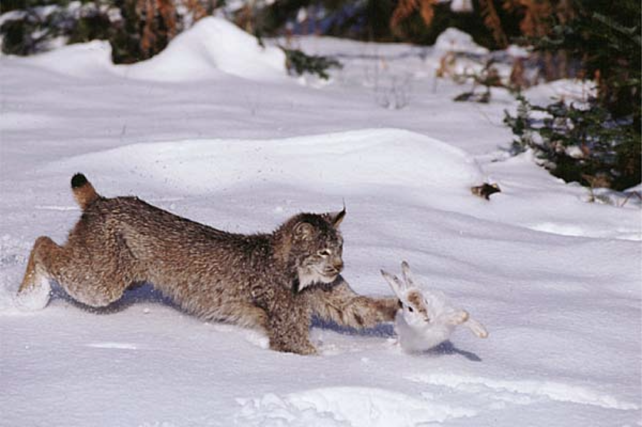
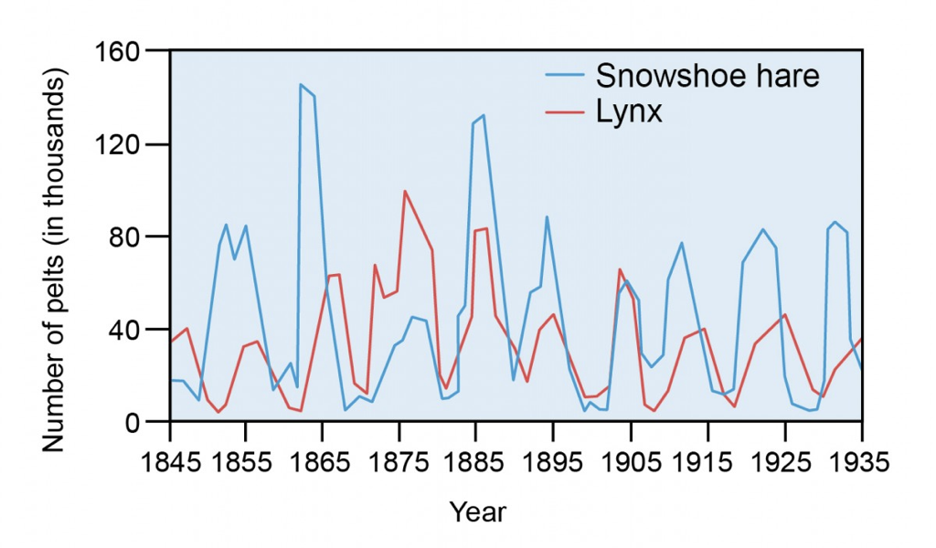
The predator-prey model
Notes:
What’s super cool about this is that this simple model, even with all of its assumptions, has been shown to play out in reality.
Study in Canada
Specialist predator

Slide 85
Key concepts
Compartmental/mechanistic/mathematical models
Modèles en compartiments
Continuous vs. discrete models
Modèles en temps continue vs. modèles en temps discrète
Deterministic vs. stochastic models
Modèles détérministique vs. stochastique
Structured models
Modèles structurés.
Two population models
Modèles des deux populations

Slide 86

What pattern can we see in simple predator-prey relationships?
Cycles / oscillations
What could we modify to make this model more complex/realistic?
Lemurs/fossa eat other things, die of other causes

Slide 87

4. SIR Models 4. Les modèles SIR

Slide 88
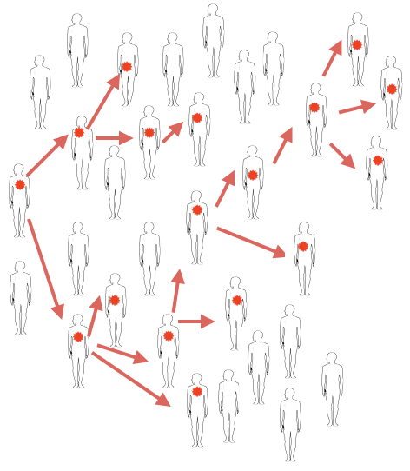
Notes:
SIR models aim to capture infection dynamics over time
This picture represents what a chain of transmission could look like , let’s say for measles through Antananarivo
Patient zero infects two people
Some infect more, some infect fewer

Slide 89
The SIR model
Compartmental models (Mechanistic Models)
1. Populations are divided into compartments
2. Individuals within a compartment are homogenously mixed
3. Compartments and transition rates are
determined by biological systems
4. Rates of transferring between compartments
are expressed mathematically
How does measles transmit through Antananarivo?
Comment la rougéole se transmet-elle à Antananarivo?
Notes:
When I say “build a model” I mean “create a stylized version of reality”. …Key to remember, all models are wrong - some models are useful…

Slide 90
The SIR model
Compartmental models (Mechanistic Models)
1. Populations are divided into compartments
2. Individuals within a compartment are homogenously mixed
3. Compartments and transition rates are
determined by biological systems
4. Rates of transferring between compartments
are expressed mathematically
susceptible
infectious
recovered
S
I
R

Slide 91
The SIR model
Compartmental models (Mechanistic Models)
1. Populations are divided into compartments
2. Individuals within a compartment are homogenously mixed
3. Compartments and transition rates are
determined by biological systems
4. Rates of transferring between compartments
are expressed mathematically
susceptible
infectious
recovered
S
I
R
What are the big assumptions here?
Notes:
Everyone is either SIR
Uniformly mixed
No latent period
Recovery is permanent
constant population size

Slide 92
The SIR model
Compartmental models (Mechanistic Models)
1. Populations are divided into compartments
2. Individuals within a compartment are homogenously mixed
3. Compartments and transition rates are
determined by biological systems
4. Rates of transferring between compartments
are expressed mathematically
everyone is either:
susceptible
infectious
recovered
S
I
R
What are the big assumptions here?

Slide 93
The SIR model
Compartmental models (Mechanistic Models)
1. Populations are divided into compartments
2. Individuals within a compartment are homogenously mixed
3. Compartments and transition rates are
determined by biological systems
4. Rates of transferring between compartments
are expressed mathematically
everyone is either:
susceptible
infectious
recovered
S
I
R
people mix uniformly (mass action)
les gens se mélangent uniformément

Slide 94
The SIR model
Compartmental models (Mechanistic Models)
1. Populations are divided into compartments
2. Individuals within a compartment are homogenously mixed
3. Compartments and transition rates are
determined by biological systems
4. Rates of transferring between compartments
are expressed mathematically
susceptible
infectious
recovered
S
I
R
infection
recovery
people mix uniformly (mass action)
no latent period
(infectious when infected)
les gens se mélangent uniformément
pas de période de latence

Slide 95
The SIR model
Compartmental models (Mechanistic Models)
1. Populations are divided into compartments
2. Individuals within a compartment are homogenously mixed
3. Compartments and transition rates are
determined by biological systems
4. Rates of transferring between compartments
are expressed mathematically
susceptible
infectious
recovered
S
I
R
recovery is permanent
infection
recovery
la récupération est permanente
people mix uniformly (mass action)
no latent period
(infectious when infected)
les gens se mélangent uniformément
pas de période de latence

Slide 96
The SIR model
Compartmental models (Mechanistic Models)
1. Populations are divided into compartments
2. Individuals within a compartment are homogenously mixed
3. Compartments and transition rates are
determined by biological systems
4. Rates of transferring between compartments
are expressed mathematically
population size constant - no births or deaths, migration
taille de population constante
susceptible
infectious
recovered
S
I
R
recovery is permanent
infection
recovery
la récupération est permanente
people mix uniformly (mass action)
no latent period
(infectious when infected)
les gens se mélangent uniformément
pas de période de latence

Slide 97
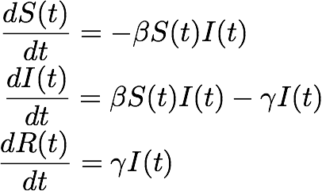
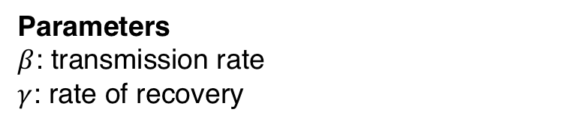
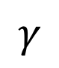
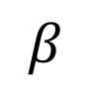
The SIR model
Compartmental models (Mechanistic Models)
1. Populations are divided into compartments
2. Individuals within a compartment are homogenously mixed
3. Compartments and transition rates are
determined by biological systems
4. Rates of transferring between compartments
are expressed mathematically
Parameters
$β$: transmission rate
$γ$: rate of recovery
susceptible
infectious
recovered
S
I
R
infection
recovery
$$β$$
$$γ$$
Notes:
Parameters
equations

Slide 98
The SIR model
Compartmental models (Mechanistic Models)
1. Populations are divided into compartments
2. Individuals within a compartment are homogenously mixed
3. Compartments and transition rates are
determined by biological systems
4. Rates of transferring between compartments
are expressed mathematically
Parameters
$β$: transmission rate
$γ$: rate of recovery
susceptible
infectious
recovered
S
I
R
transmission
recovery
$$β$$
$$γ$$
…infected numbers influence the transmission rate….

Slide 99
The SIR model
Compartmental models (Mechanistic Models)
1. Populations are divided into compartments
2. Individuals within a compartment are homogenously mixed
3. Compartments and transition rates are
determined by biological systems
4. Rates of transferring between compartments
are expressed mathematically
Parameters
$β$: transmission rate
$γ$: rate of recovery
susceptible
infectious
recovered
S
I
R
transmission
recovery
$$β$$
$$γ$$
What will the dynamics look like?

Slide 100
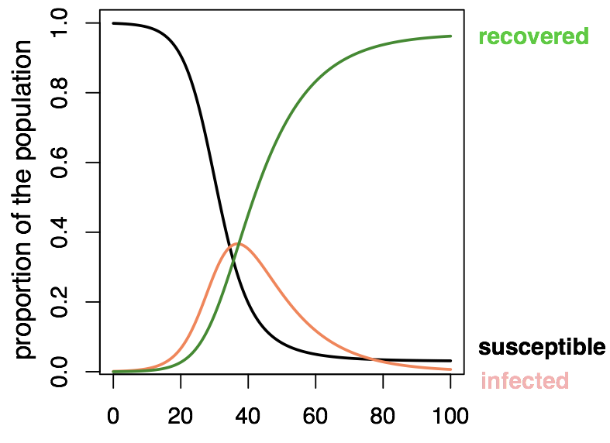
The SIR model

Slide 101
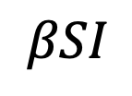
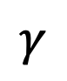
The SIR model
Set: I=1
I
transmission
recovery
$$βSI$$
$$γ$$
The average number of persons infected by an infectious individual when everyone is susceptible (S=100%, or S=1, start of an epidemic)
Notes:
Look just at the very start of an outbreak
Set I = 1, you can calculate a value for R0, which is:

Slide 102
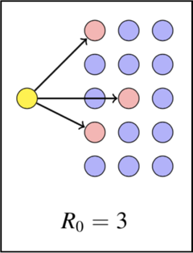
The SIR model
Notes:
For example,

Slide 103
The SIR model
Notes:
For example,

Slide 104
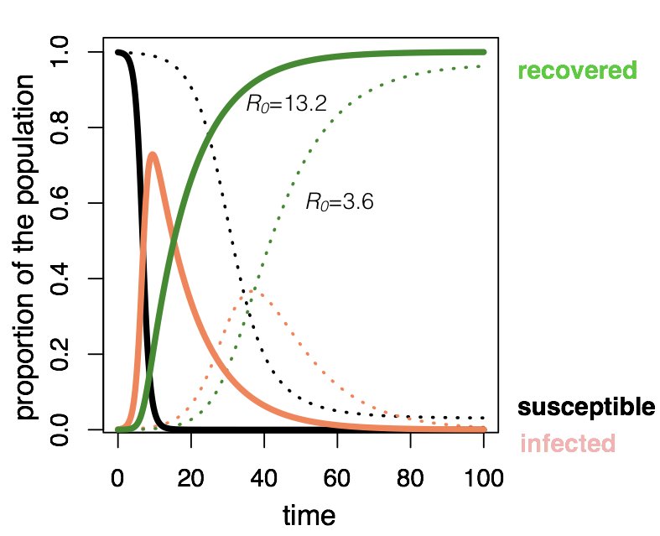
The SIR model
Which has the higher R0 value?
Notes:
High R0 (13.2) -- very fast infection
Lower R0 – slower infection

Slide 105
The SIR model
Notes:
High R0 (13.2) -- very fast infection
Lower R0 – slower infection

Slide 106

What is R0?
The average number of secondary infections from the first infectious individual
How could you modify this simple SIR model to represent COVID-19?

Slide 107
The SIR model : vaccination
S
I
R
transmission
recovery
vaccination
Vaccination moves people out of susceptibles into the immune (recovered) class.
La vaccination éloigne les personnes sensibles de la maladie dans la classe immunitaire (rétablie).

Slide 108
The SIR model : vaccination
S
I
R
transmission
recovery
vaccination
Vaccination moves people out of susceptibles into the immune (recovered) class.
La vaccination éloigne les personnes sensibles de la maladie dans la classe immunitaire (rétablie).

Slide 109
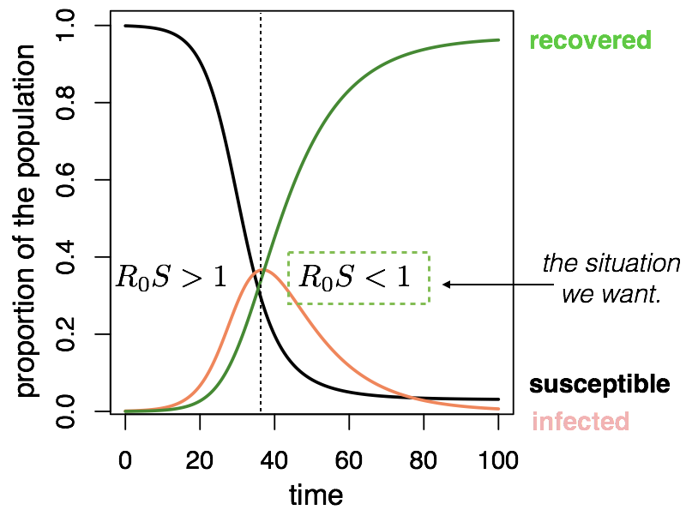
The SIR model : vaccination

Slide 110
The SIR model : vaccination
Proportion that needs to be vaccinated to interrupt transmission

Slide 111
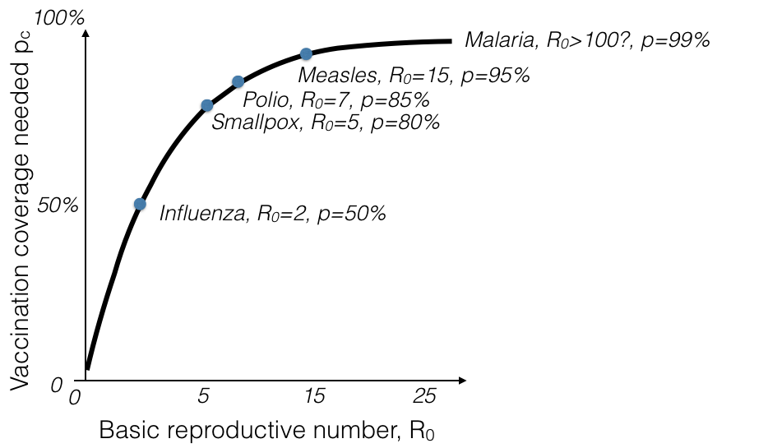
The SIR model : eradication
More transmissible diseases are harder to eradicate
Notes:
Look across different diseases

Slide 112
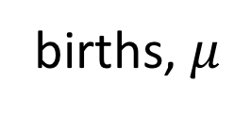
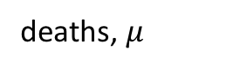
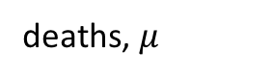
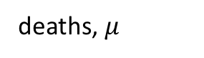
The SIR model : extensions
Moving beyond a ‘closed’ population
births, $μ$
transmission
recovery
S
I
R
vaccination, p
deaths, $μ$
deaths, $μ$
deaths, $μ$
Notes:
Births and deaths
vaccination

Slide 113
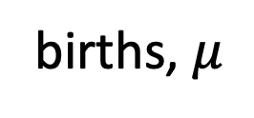
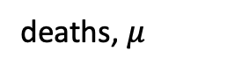
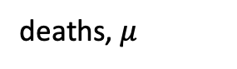
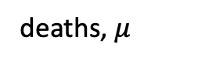
The SIR model : extensions
Moving beyond a ‘closed’ population
births, $μ$
transmission
recovery
S
I
R
vaccination, p
deaths, $μ$
deaths, $μ$
deaths, $μ$
Notes:
Births and deaths
vaccination

Slide 114
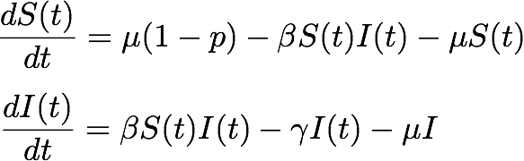
The SIR model : extensions
Moving beyond a ‘closed’ population
births, $μ$
transmission
recovery
S
I
R
vaccination, p
deaths, $μ$
deaths, $μ$
deaths, $μ$
Notes:
Show deaths
Show births
Show vaccinations

Slide 115
The SIR model : add births
Moving beyond a ‘closed’ population
births, $μ$
transmission
recovery
S
I
R
vaccination, p
deaths, $μ$
deaths, $μ$
deaths, $μ$
How will births impact dynamics?

Slide 116
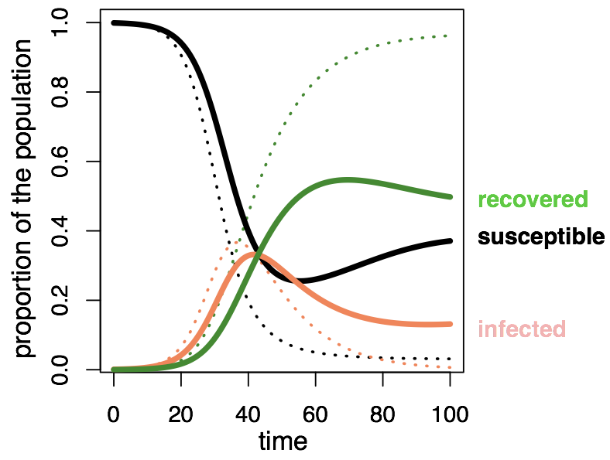
The SIR model : add births
Notes:
Births!
If we keep adding susceptibles to the population, infection will persist

Slide 117
Beyond the SIR model
births, $μ$
transmission
recovery
S
I
R
vaccination, p
deaths, $μ$
deaths, $μ$
deaths, $μ$
What do we change if infection is always FATAL?
Notes:
Guess?

Slide 118

Beyond the SIR model
births, $μ$
transmission
S
I
vaccination, p
deaths, $α$
deaths, $μ$
deaths, $μ$
What do we change if infection is always FATAL?
Notes:
Instead of recovered class, we remove it entirely and infectious individuals are lost from the population

Slide 119
Beyond the SIR model
births, $μ$
transmission
recovery
S
I
R
vaccination, p
deaths, $μ$
deaths, $μ$
deaths, $μ$
What if immunity wanes?

Slide 120
Beyond the SIR model
waning immunity
births, $μ$
transmission
recovery
S
I
R
vaccination, p
deaths, $μ$
deaths, $μ$
deaths, $μ$
What if immunity wanes?

Slide 121
Beyond the SIR model
births, $μ$
transmission
recovery
S
I
R
vaccination, p
deaths, $μ$
deaths, $μ$
deaths, $μ$
What if people recover at different rates?

Slide 122
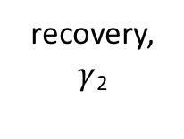
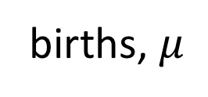
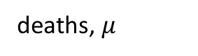
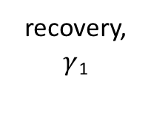
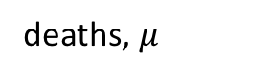

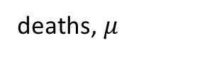
Beyond the SIR model
births, $μ$
transmission
recovery, $γ$₁
vaccination, p
S
I₁
R
deaths, $μ$
deaths, $μ$
deaths, $μ$
transmission
I₂
recovery, $γ$₂
deaths, $μ$
What if people recover at different rates?

Slide 123
Key concepts
Compartmental/mechanistic/mathematical models
Modèles en compartiments
Continuous vs. discrete models
Modèles en temps continue vs. modèles en temps discrète
Deterministic vs. stochastic models
Modèles détérministique vs. stochastique
Structured models
Modèles structurés.
Two population models
Modèles des deux populations
SIR models – and beyond!
Modèles SIR – et au délà!

Slide 124

“All models are _____, some models are_____.”

Slide 125
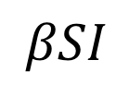
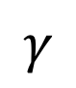
The SIR model
Set: I=1
I
transmission
recovery
$$βSI$$
$$γ$$
The average number of persons infected by an infectious individual when everyone is susceptible (S=100%, or S=1, start of an epidemic)
R_{E} =
“R-effective"
…as the epidemic progresses and S falls
Notes:
Back to SIR, and how an epidemic ends with some susceptibles still left over
Another value of R that’s important is R effective, which is R0 * S
Number of secondary infections at points in time other than just the initial outbreak stage
Changes throughout an epidemic as the value of S changes

Slide 126
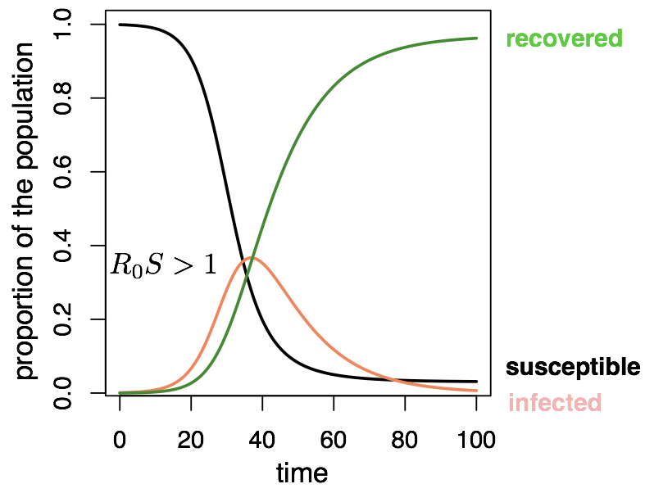
The SIR model

Slide 127
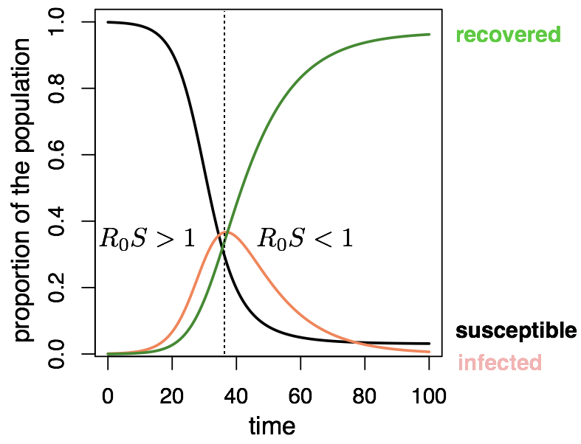
The SIR model
Notes:
When Re is < 1, cases fall eventually to 0

Slide 128
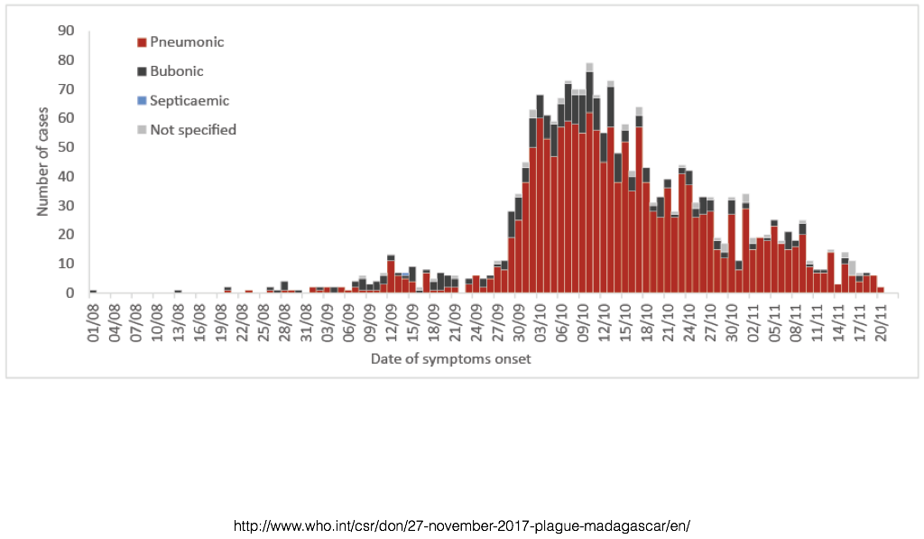
Which model?
Notes:
and the point will be it depends on the question.
https://www.ncbi.nlm.nih.gov/pmc/articles/PMC2566243/

